Slide 2
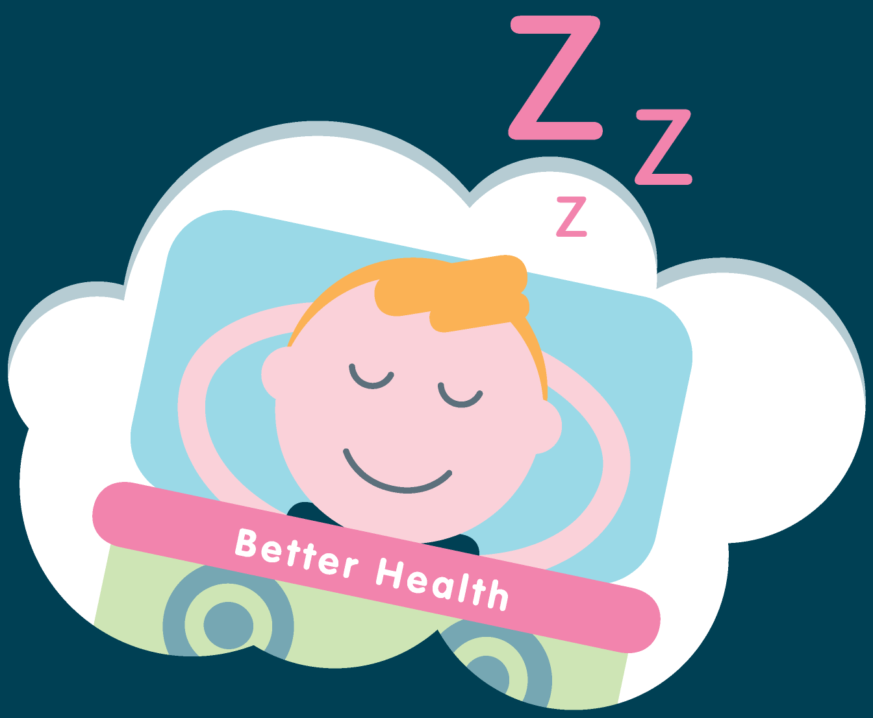
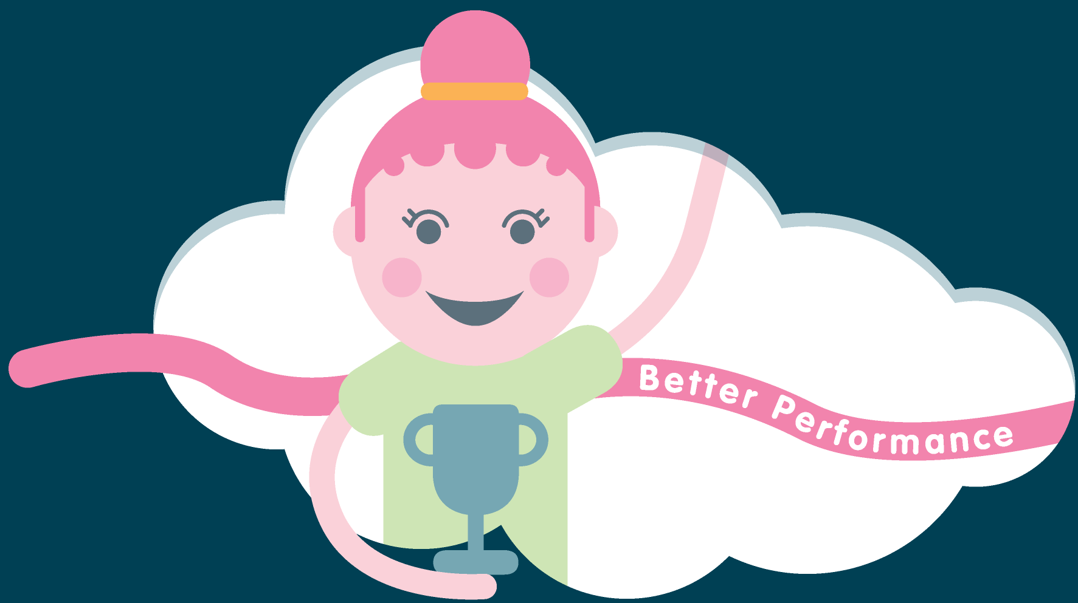
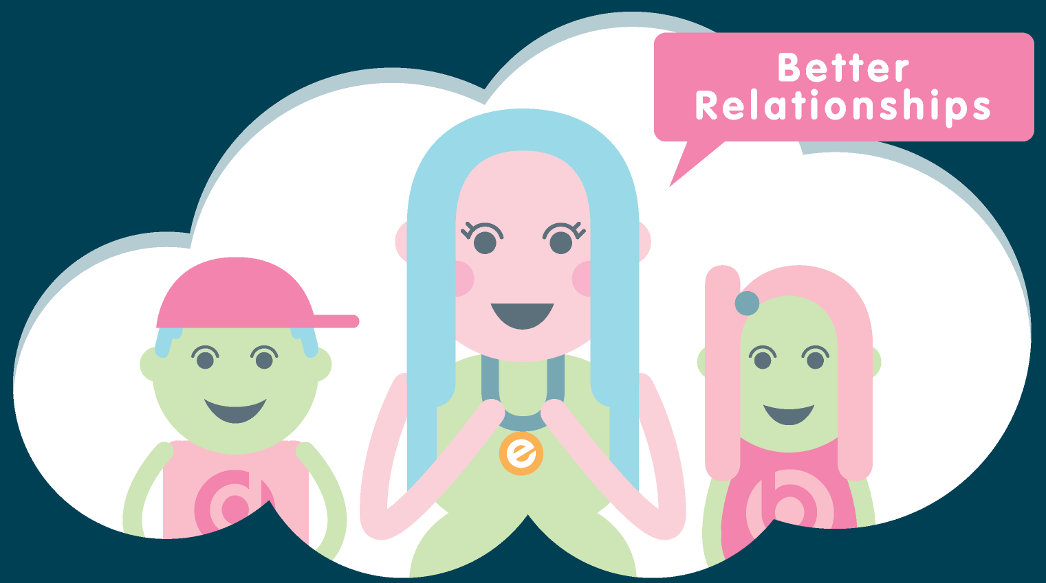
Today’s Plan
What is Mindfulness and how do you practise?
Why Mindfulness - technology, ACE's, trauma and Covid-19
Why I got into Mindfulness
The benefits of Mindfulness for children and adults
The science of Mindfulness
Short breathing practice
Mindfulness in the primary years & Resilience-based Recovery

Slide 3
What is Mindfulness?
Mindfulness means paying attention in a particular
way: on purpose, in the present moment, and
non-judgementally.
Jon Kabat Zinn
“
”
“
Mindfulness isn’t difficult, we just need to
remember to do it.
Sharon Salzberg
”

Slide 4
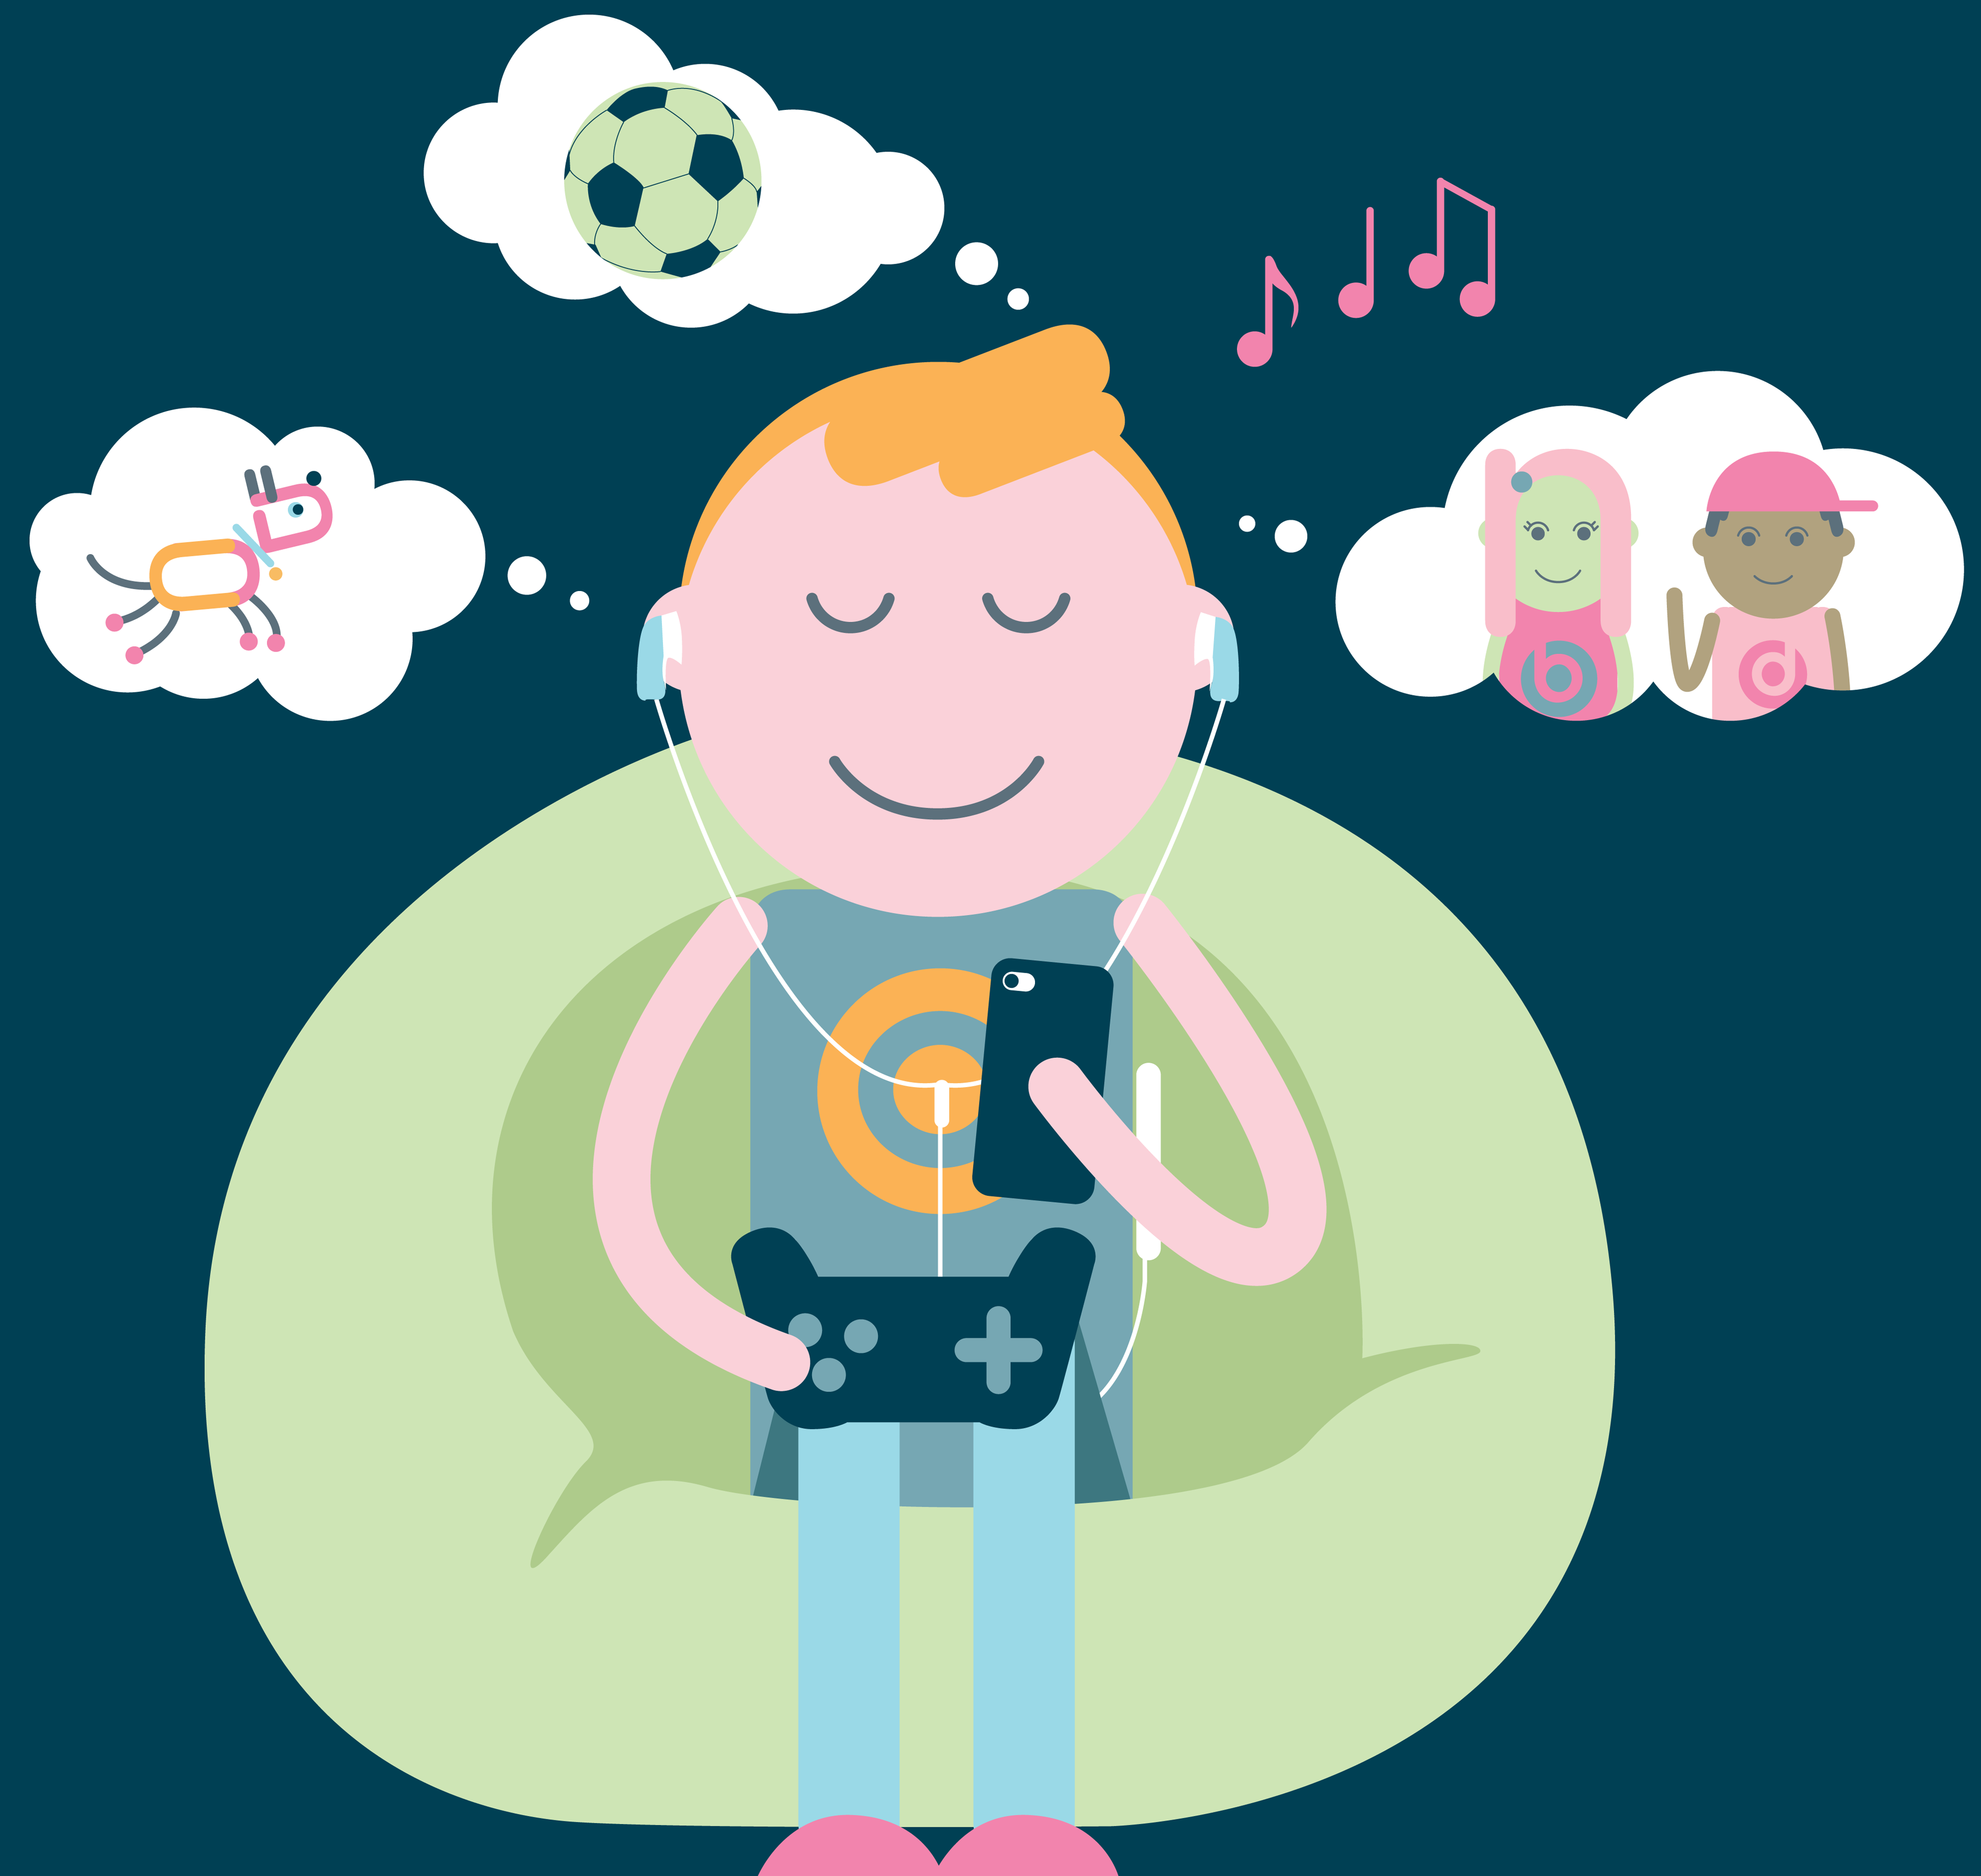
Why Mindfulness?
Digital age - constant stimulus affects our ability to pay attention
ACEs - 1 in 4
COVID-19 - extra stress, uncertainty, collective trauma?
Anxiety, stress and depression have never before been so prevalent.
Research shows that poor mental health negatively impacts on attainment and life chances.
Early intervention and prevention strategies are key to minimising the prevalence and severity of poor mental health.
Mindfulness is one evidence-based intervention that can benefit mental health and emotional wellbeing.

Slide 5
Why I got into Mindfulness

Slide 6
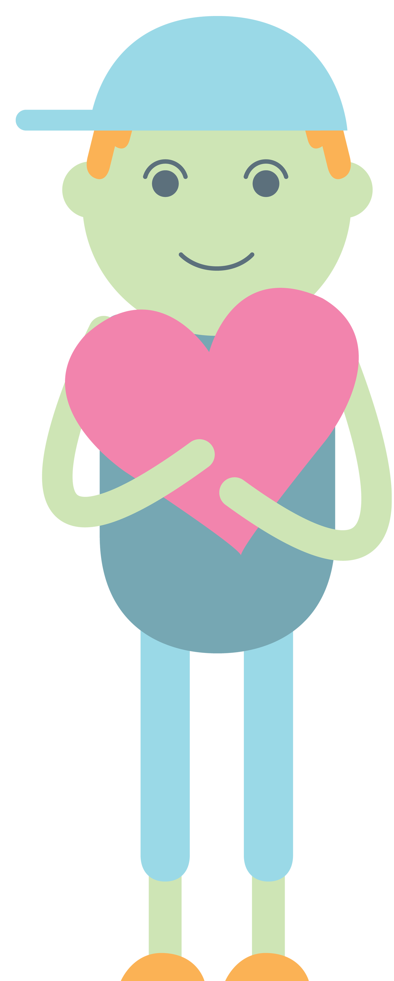
Adults
Lowers blood pressure
Improves attention/ concentration
Lessens reactivity
Improves depression/anxiety
Improves self-compassion and compassion for others
Builds resilience
Children
Improves attention, readiness to learn and impulse control.
Improves pro-social qualities like empathy, generosity, kindness, tolerance, compassion and ability to connect

Slide 8
Let’s do it! Mindful Breathing Practice

Slide 9
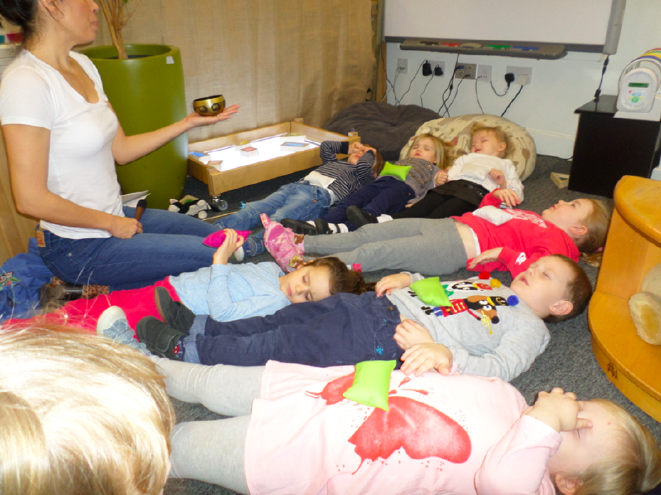

Slide 10
Re-Cap
1) Practice Mindfulness
How you are is more important than what you do
Be as open, present and curious as possible
Model the skills you are developing in children
2) Set an intention to consciously connect
Kids learn to regulate through regulated adults - brains and nervous systems are incomplete
Need to feel safe and connected to learn
The younger/more traumatised the child the more they depend on our reciprocity and attunement and will be very sensitive to our internal state - pick up on micro facial expressions, posture etc
3) Short regular Mindfulness-based practices
• Daily breathing practice • Alternatives • Props to engage senses • Take time to reflect
Don’t Dabble!
• Don’t dabble!

Slide 12
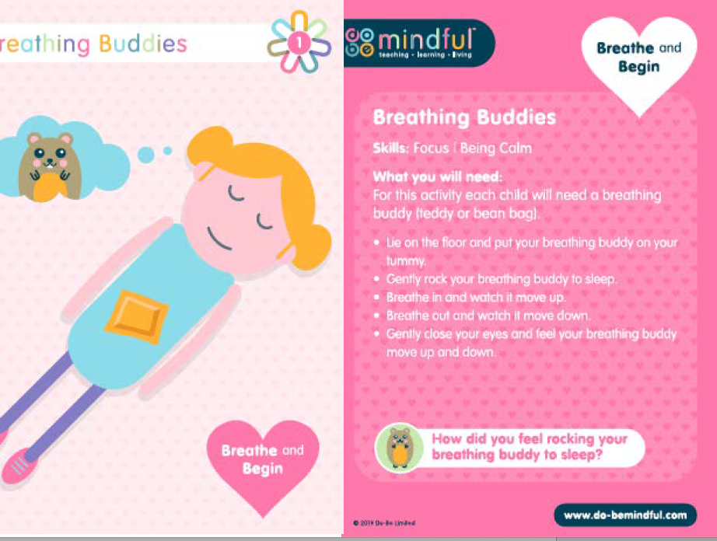

Slide 15
Explorer's LI's & E's & O's
9
© 2020 Do-B
e Limited.

Slide 16
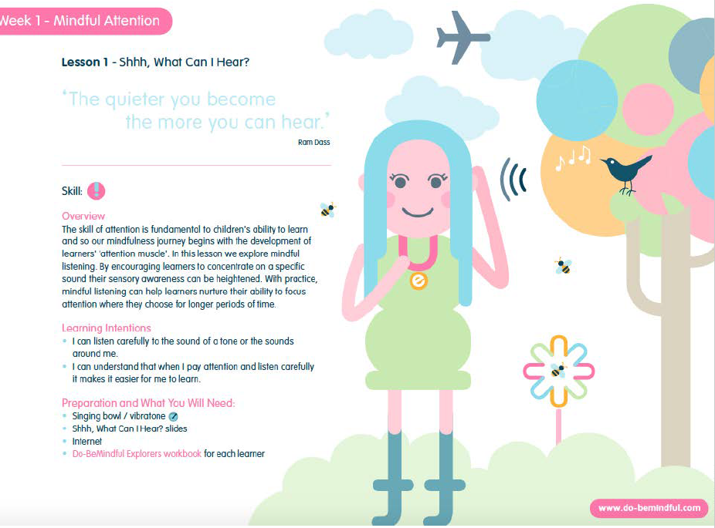

Slide 17
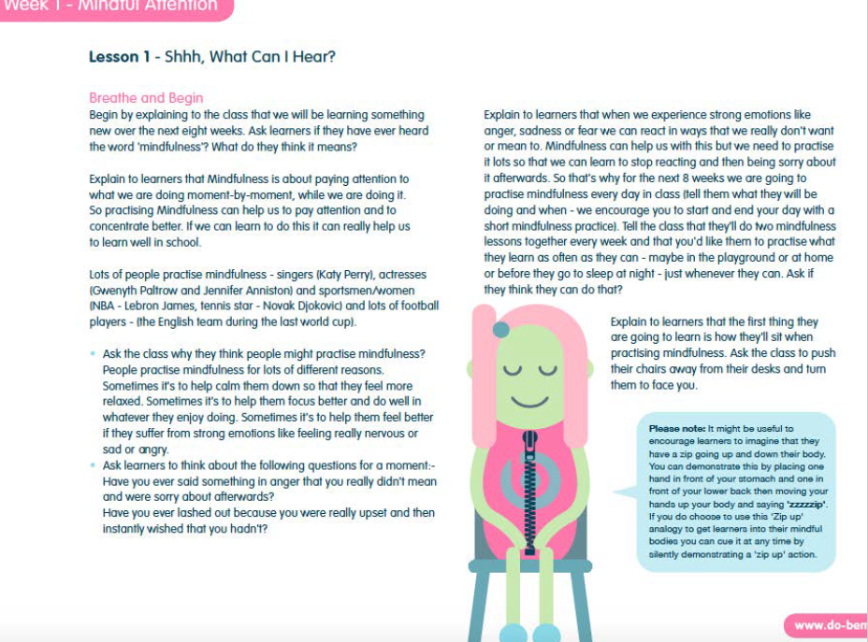

Slide 19
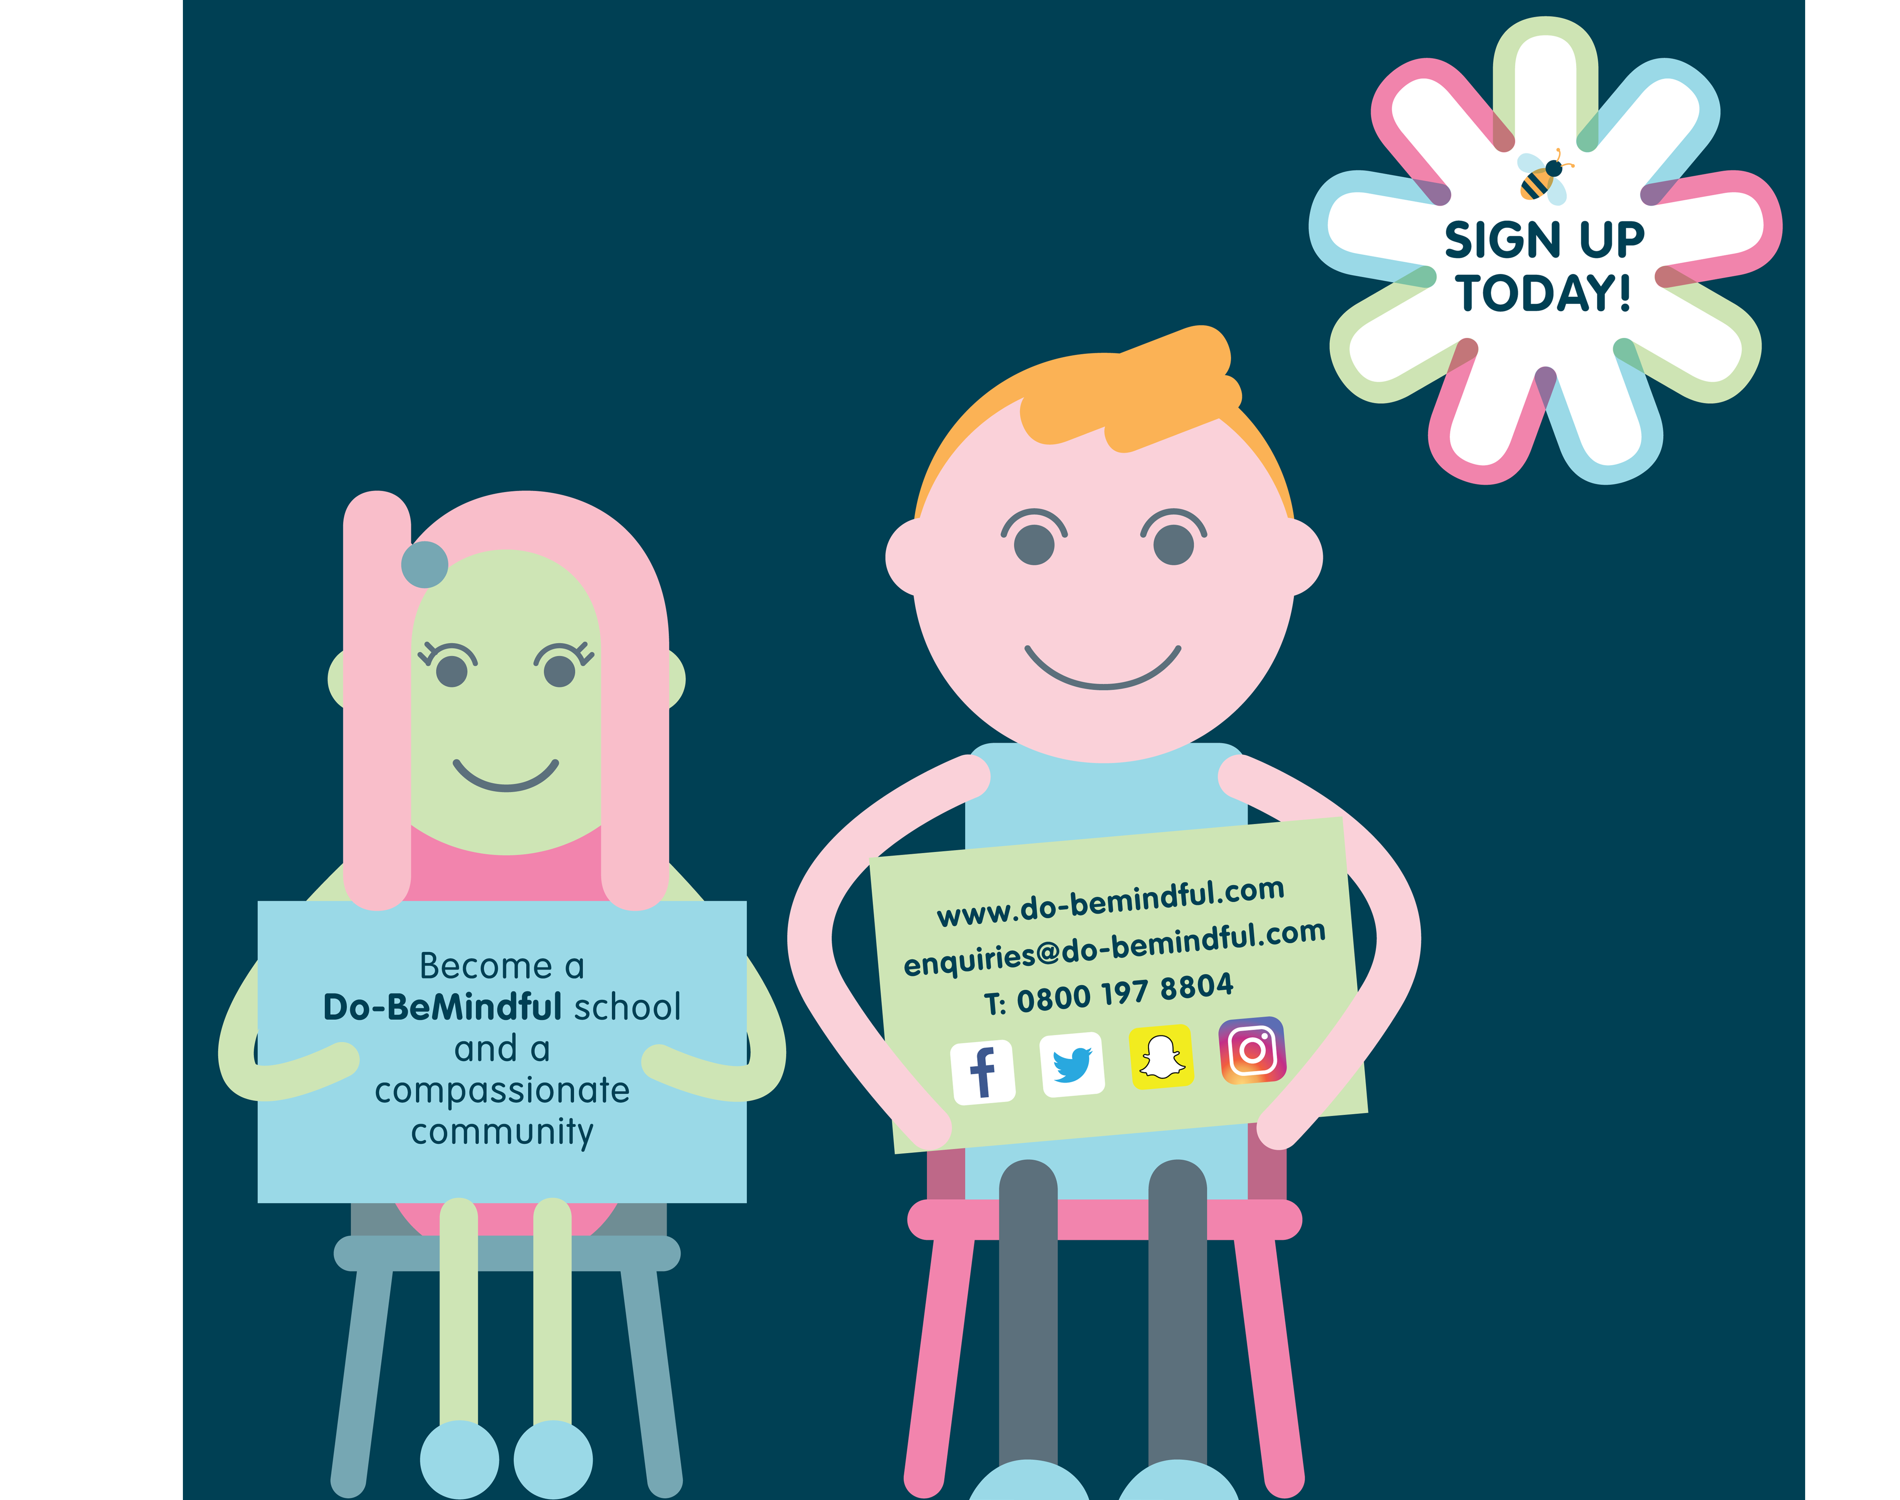
Questions?
Do-BeMindful - Facebook
@dobelou - twitter
louise@do-bemindful.com

