Slide 1
Resilience and Wellbeing Event 18th May 2021
Louise Smith, Director and Founder
www.Do-BeMindful.com
© 2021 Do-Be Limited

Slide 2
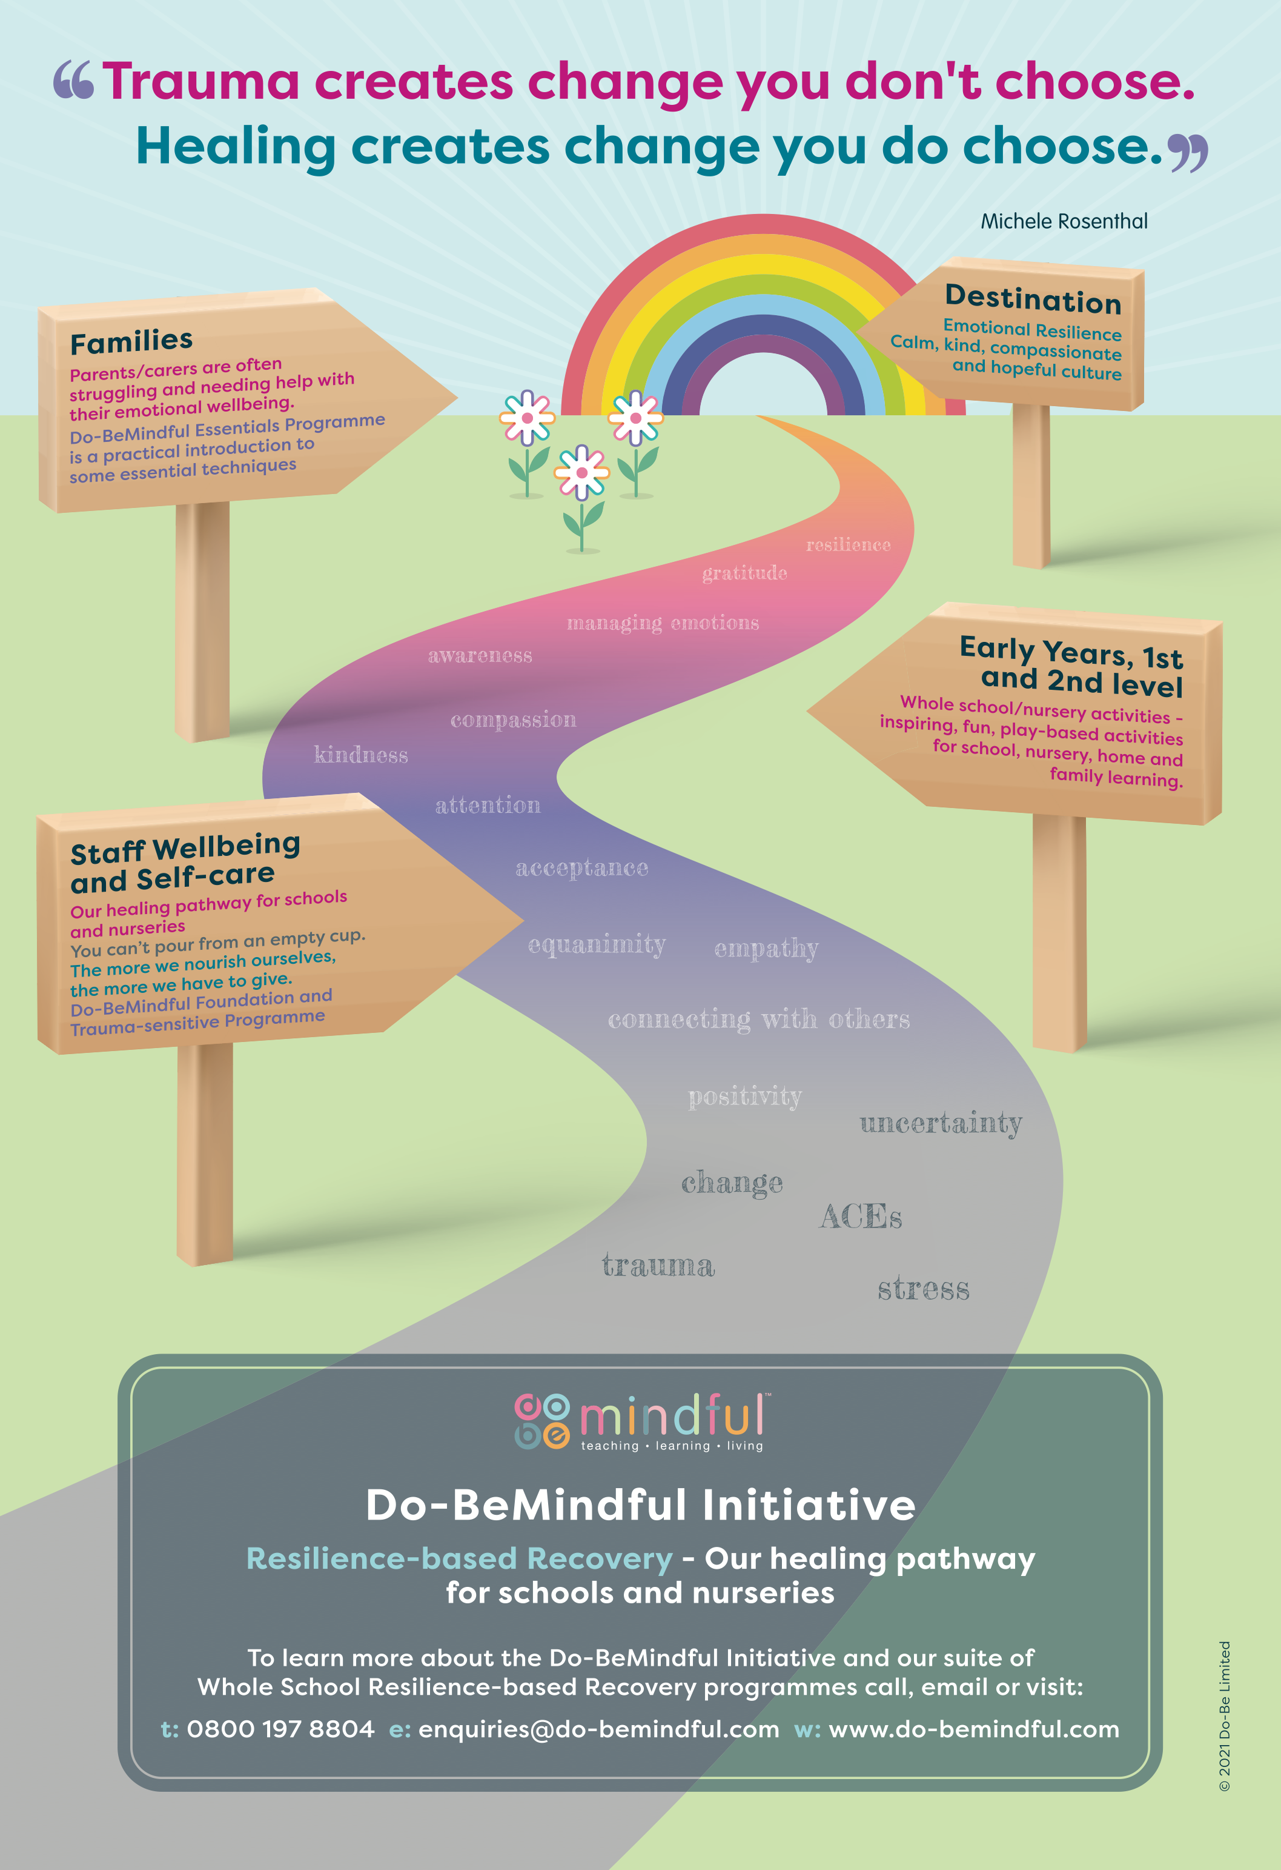

Slide 4
What is Mindfulness?
“
Mindfulness means paying attention
in a particular way: on purpose,
in the present moment, and
non-judgementally.
Jon Kabat Zinn
”
“
Mindfulness isn’t difficult,
we just need to remember
to do it.
Sharon Salzberg
”
© 2021 Do-Be Limited

Slide 5
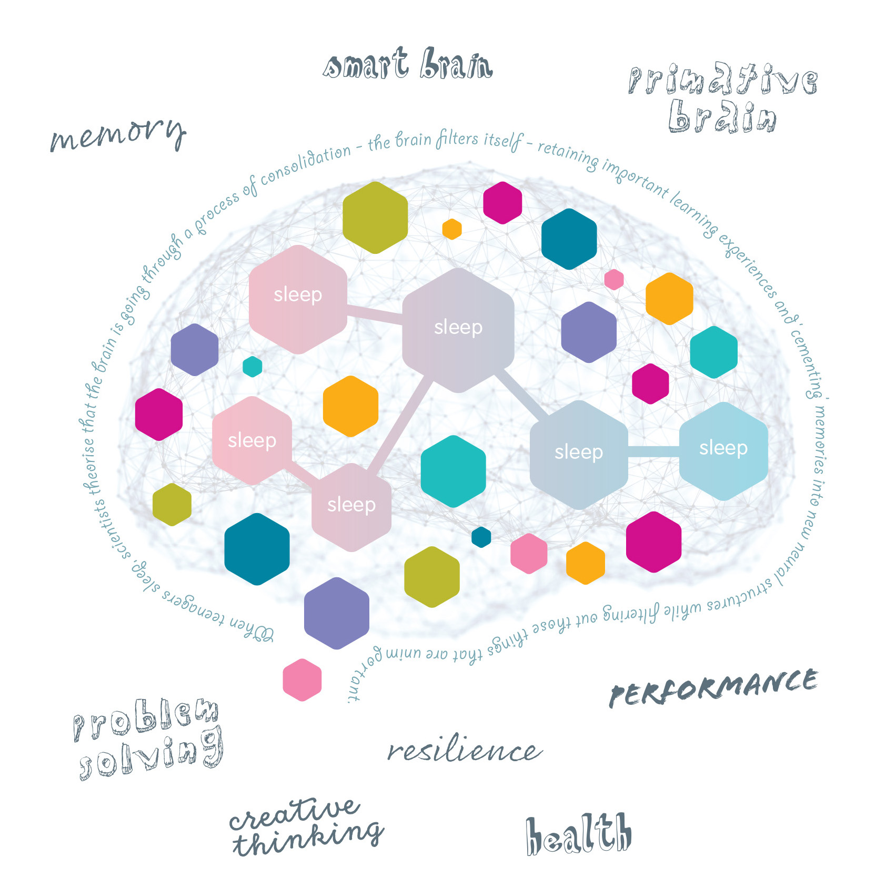
Benefits
Adults
• Improves attention/ concentration
• Lessens reactivity
• Improves depression/anxiety
• Improves self-compassion and
• compassion for others
• Builds resilience
Young Adults
• Improves attention
• Improves self-regulation
• Improves skills like compassion,
• kindness and empathy
© 2021 Do-Be Limited

Slide 6
Short Mindful Breathing Practice
“
You yourself,
as much as anybody in the entire universe,
deserve your love and affection.”
Buddha
”
© 2021 Do-Be Limited

Slide 7
Why I got into Mindfulness

Slide 8
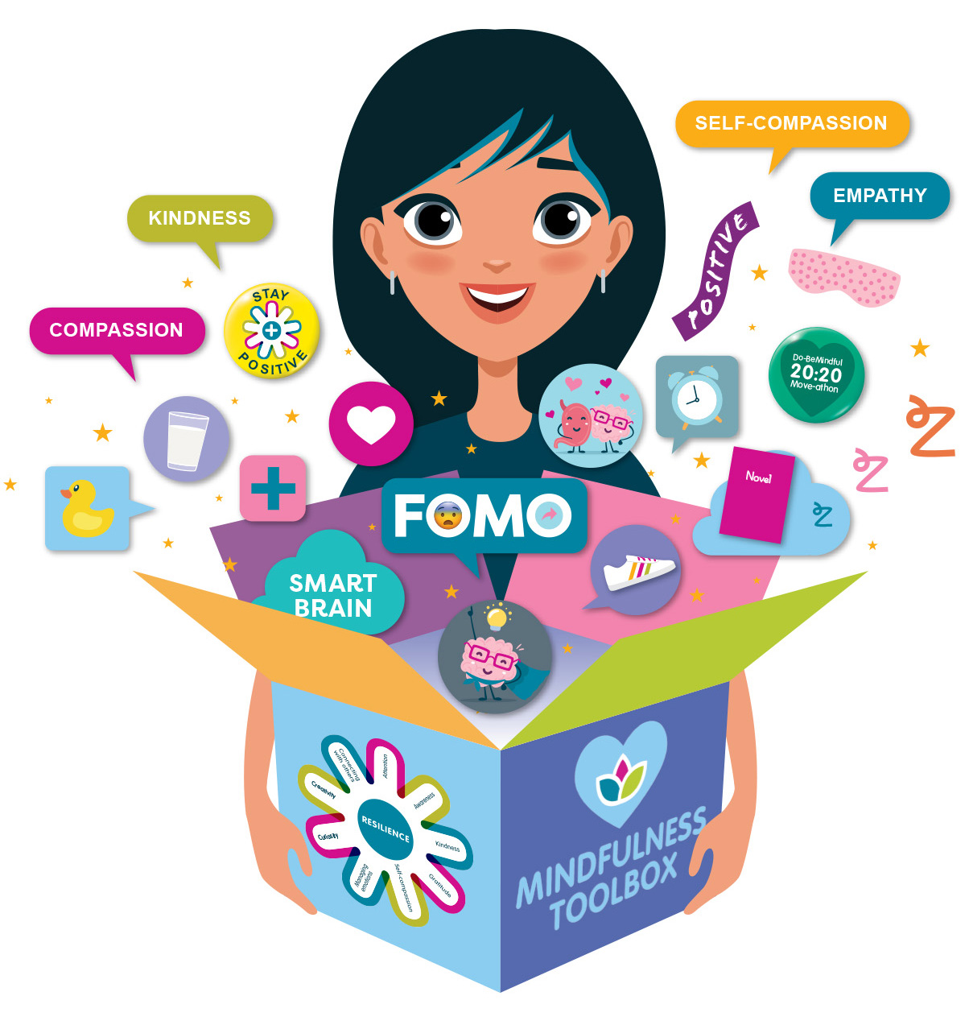
Resilience-based Recovery
Inspiring and empowering mindfulness-based activities which build a ‘Mindfulness Toolbox’ to nurture healthy habits of
mind and essential coping skills.
Reflection
Coping with Uncertainty
Relationships
and Connecting
Nutrition
Gratefulness and Positive Thoughts
Sleep
Device-free
Time
Physical
Exercise
© 2021 Do-Be Limited

Slide 9
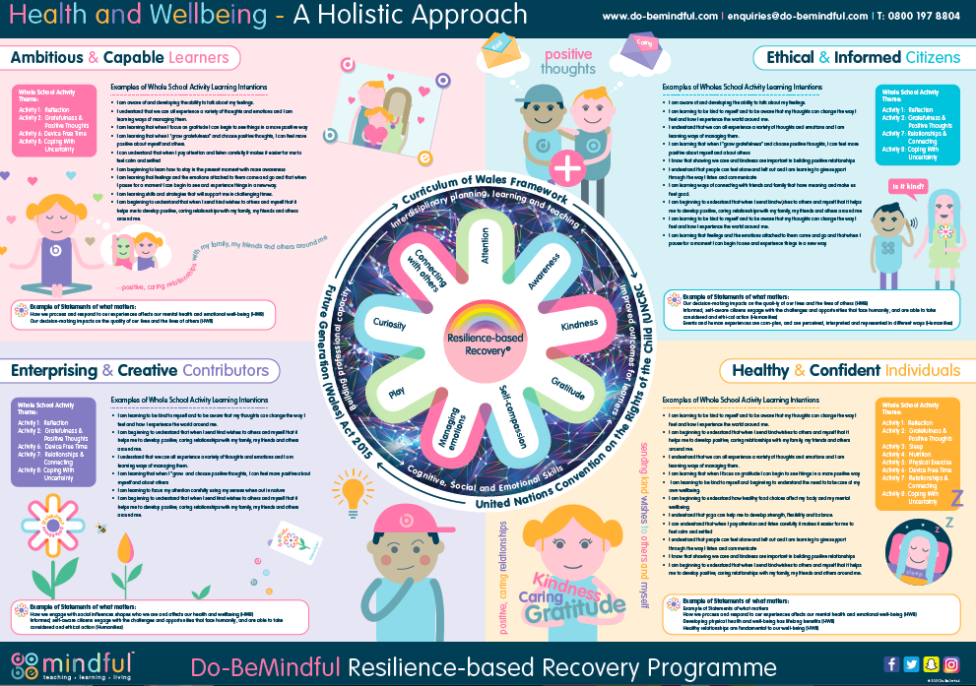

Slide 10
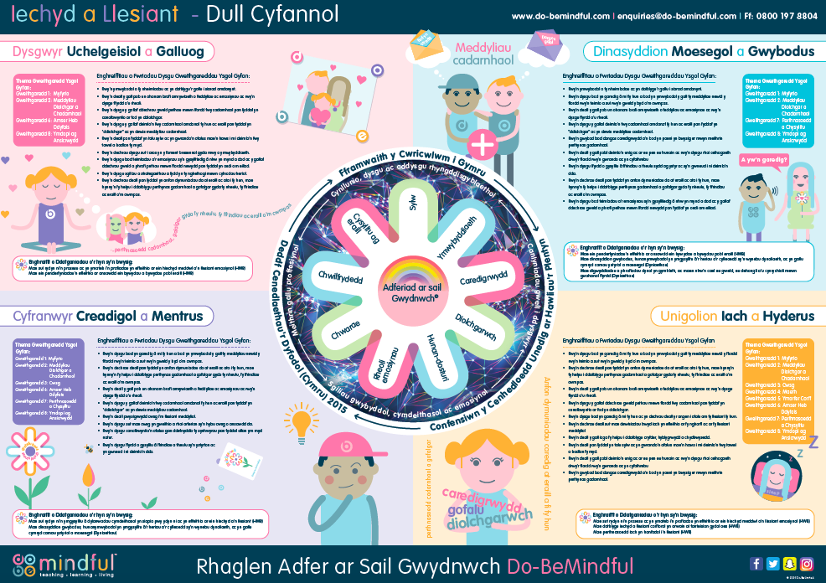

Slide 11
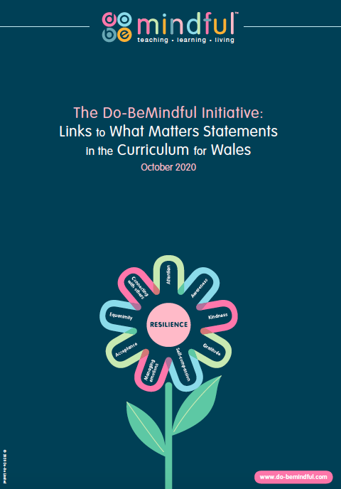

Slide 12
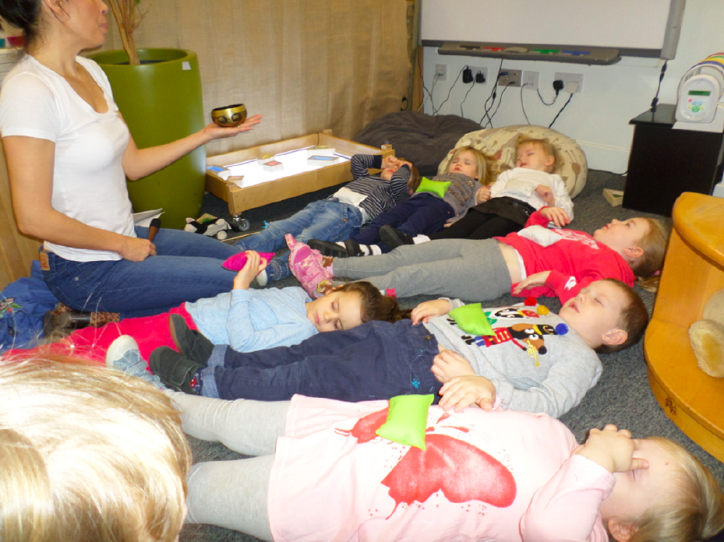

Slide 13
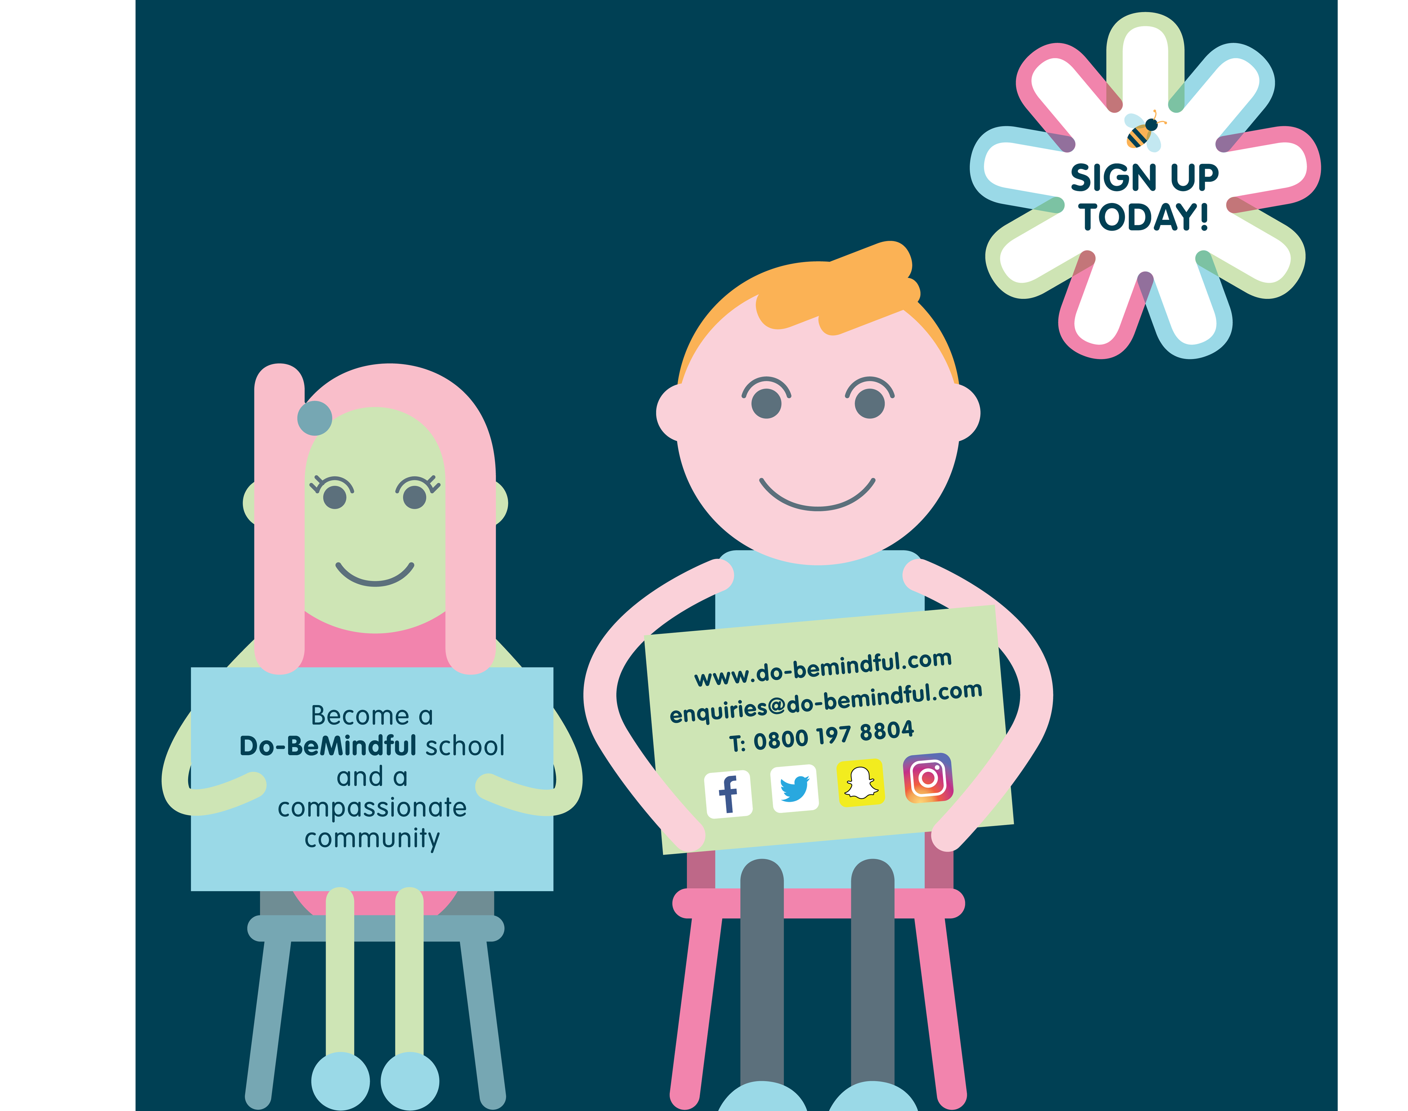
Questions?
Do-BeMindful - Facebook
@dobelou - twitter
louise@do-bemindful.com

