Slide 1
Wellbeing and Resilience 26th May 2021
Louise Smith, Director and Founder
www.Do-BeMindful.com
© 2021 Do-Be Limited

Slide 2
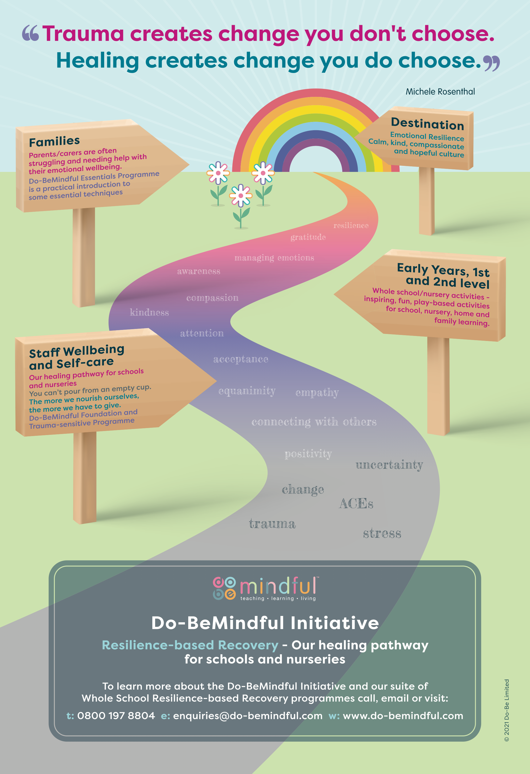

Slide 4
What is Mindfulness?
“
Mindfulness means paying attention
in a particular way: on purpose,
in the present moment, and
non-judgementally.
Jon Kabat Zinn
”
“
Mindfulness isn’t difficult,
we just need to remember
to do it.
Sharon Salzberg
”
© 2021 Do-Be Limited

Slide 5
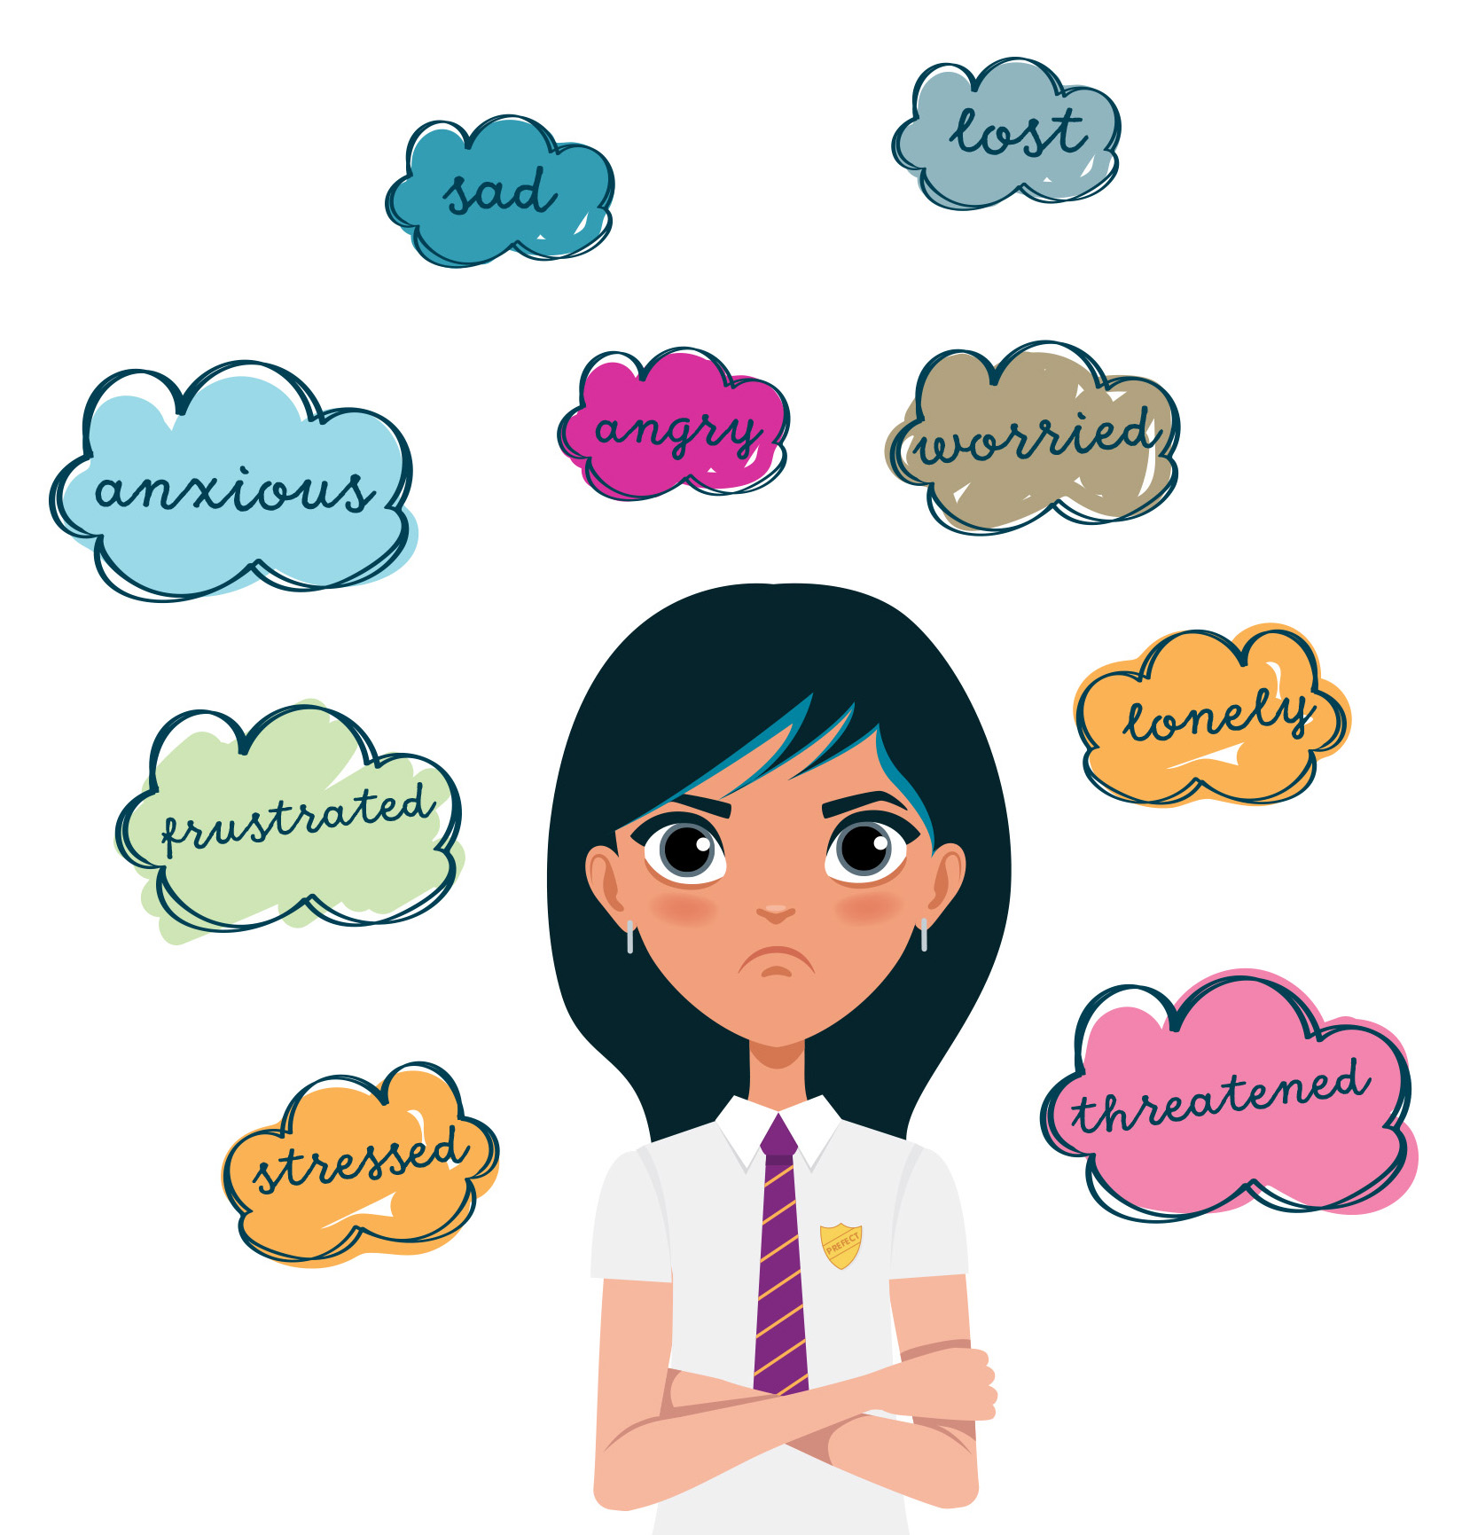
“
Mindfulness has a way of befriending
Ourselves and our experience.
Jon Kabat-Zinn
”
Why Mindfulness?
Anxiety, stress and depression have never before been so prevalent in both adults and young people. Research shows that poor mental health negatively impacts on attainment and life chances.
Early intervention and prevention strategies are
key to minimizing the prevalence and severity
of poor mental health.
Mindfulness is one evidence-based intervention
that can benefit both adults' and childrens’
mental health and emotional wellbeing.
© 2021 Do-Be Limited

Slide 6
Why I got into Mindfulness

Slide 7
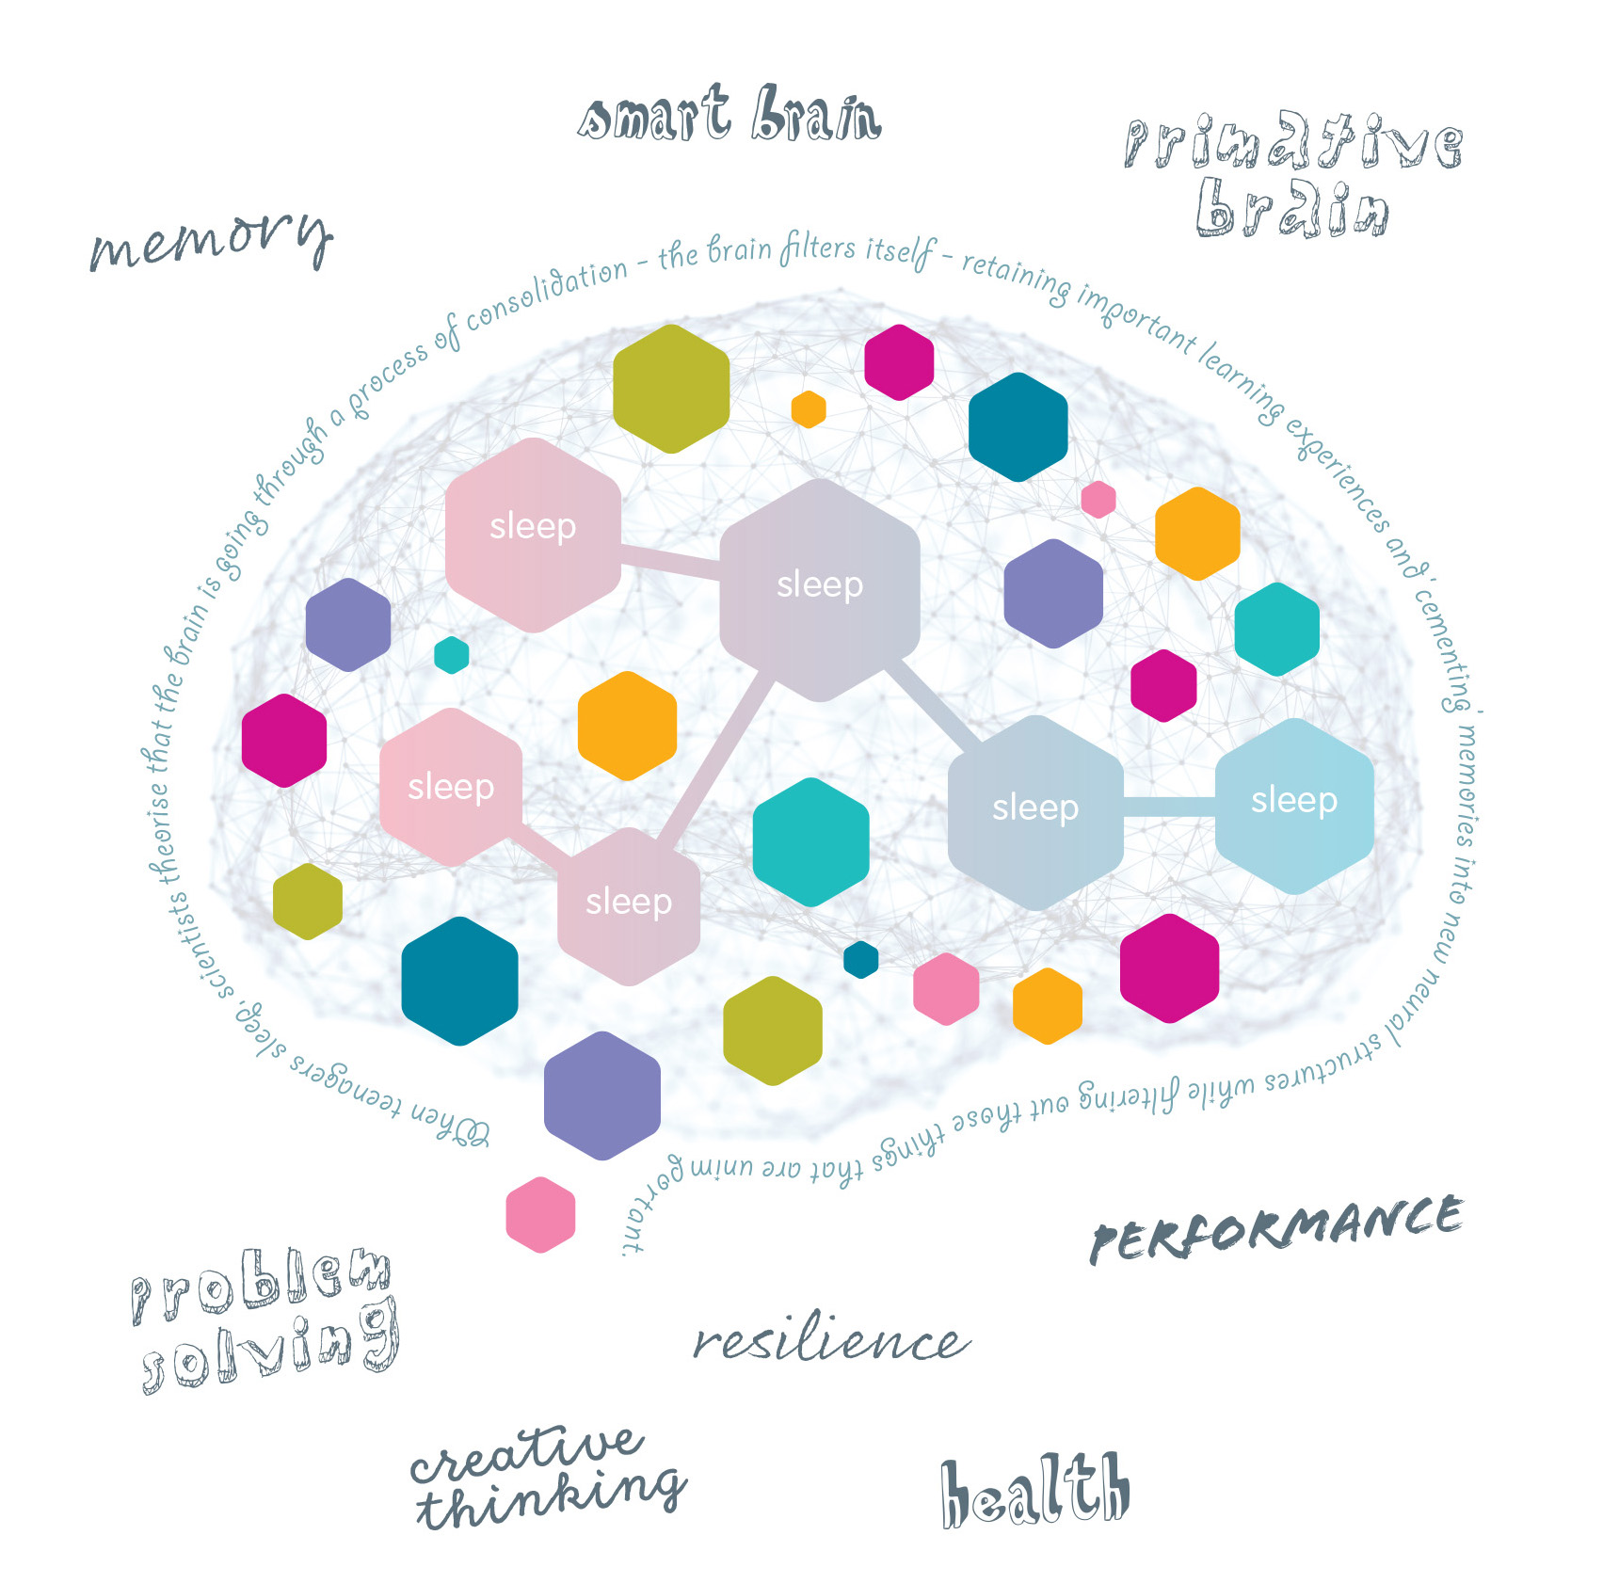
Benefits
Adults
• Improves attention/ concentration
• Lessens reactivity
• Improves depression/anxiety
• Improves self-compassion and
• compassion for others
• Builds resilience
Young Adults
• Improves attention
• Improves self-regulation
• Improves skills like compassion,
• kindness and empathy
© 2021 Do-Be Limited

Slide 8
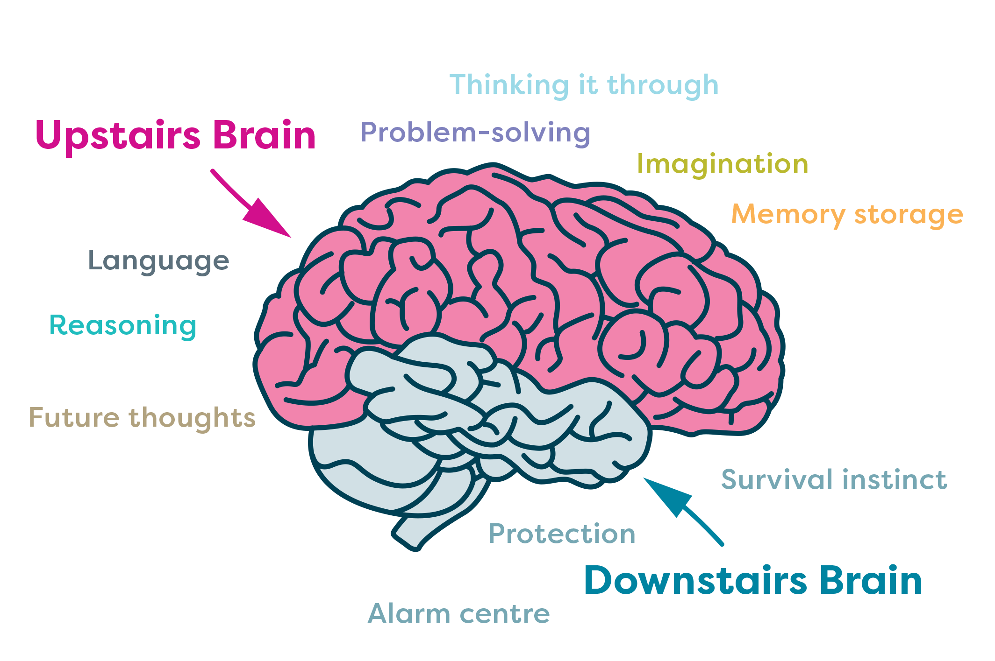
Science - what happens in our brains
Smart part
of our brains
Primitive part
of our brains
© 2021 Do-Be Limited

Slide 9
Short Mindful Breathing Practice
“
You yourself,
as much as anybody in the entire universe,
deserve your love and affection.”
Buddha
”
© 2021 Do-Be Limited

Slide 13
Measuring Impact
© 2021 Do-Be Limited

Slide 14
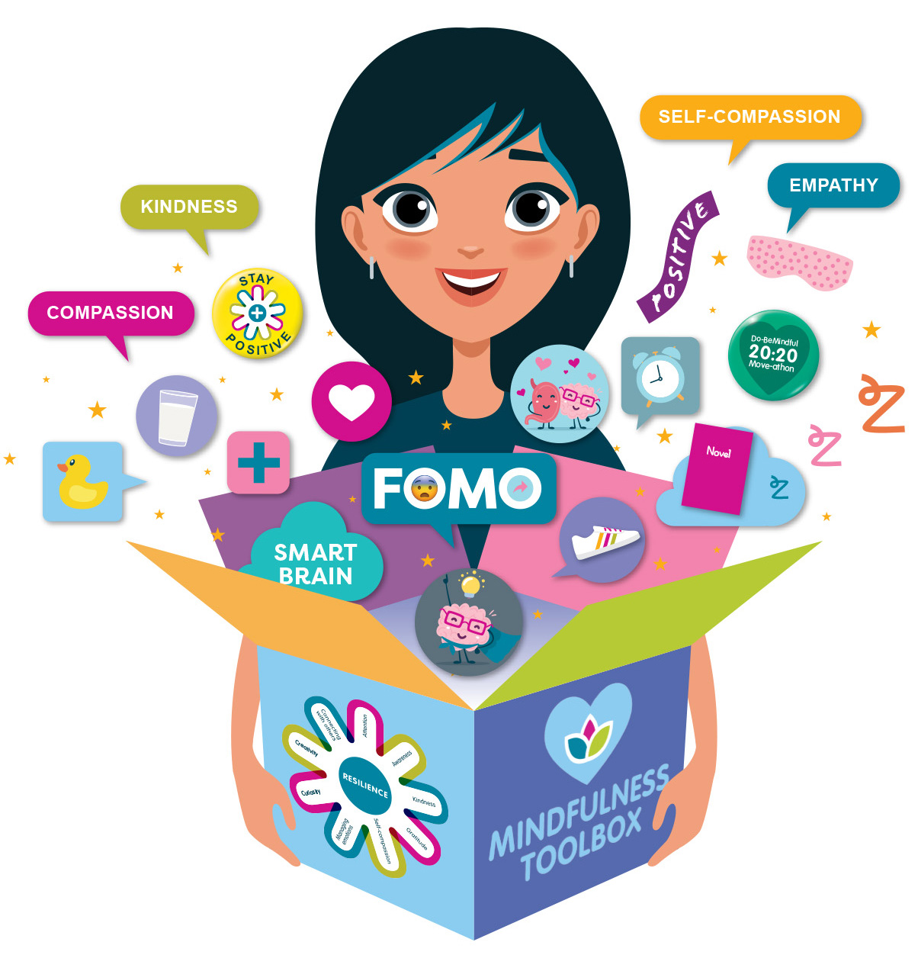
Do-BeMindful Resilience-based Recovery Programme for Early Years,
Inspiring and empowering mindfulness-based activities which build a ‘Mindfulness Toolbox’ to nurture healthy habits of
mind and essential coping skills.
Reflection
Coping with Uncertainty
Relationships
and Connecting
Nutrition
Gratefulness and Positive Thoughts
Sleep
Device-free
Time
Physical
Exercise
© 2021 Do-Be Limited

Slide 15
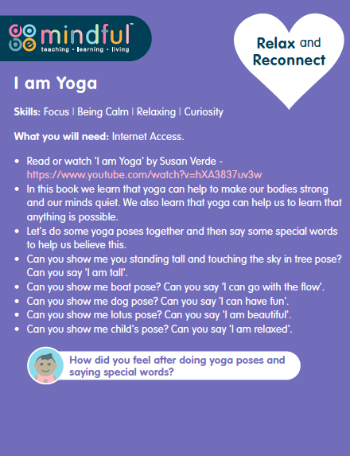
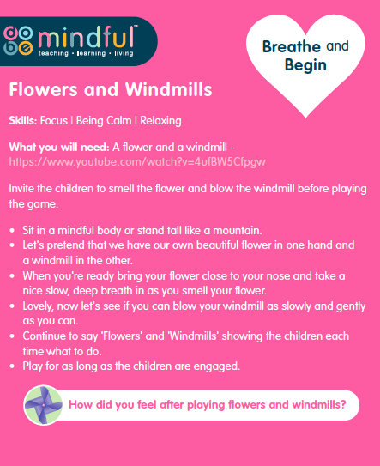
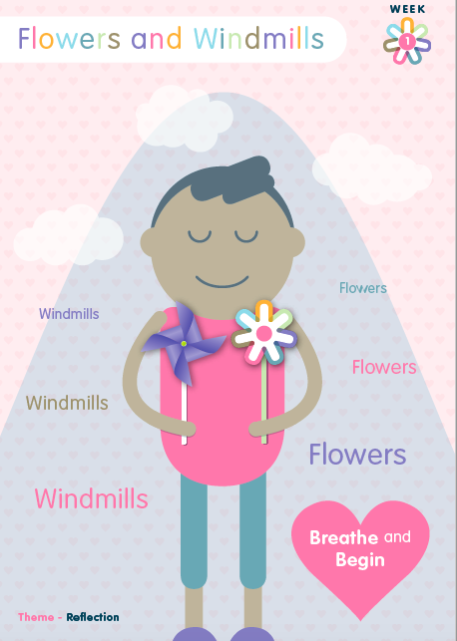
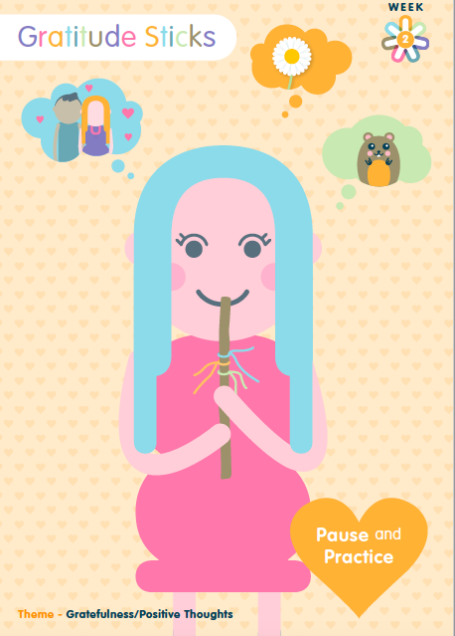
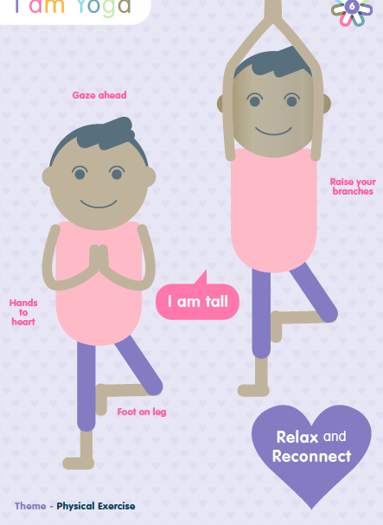
© 2021 Do-Be Limited

Slide 16
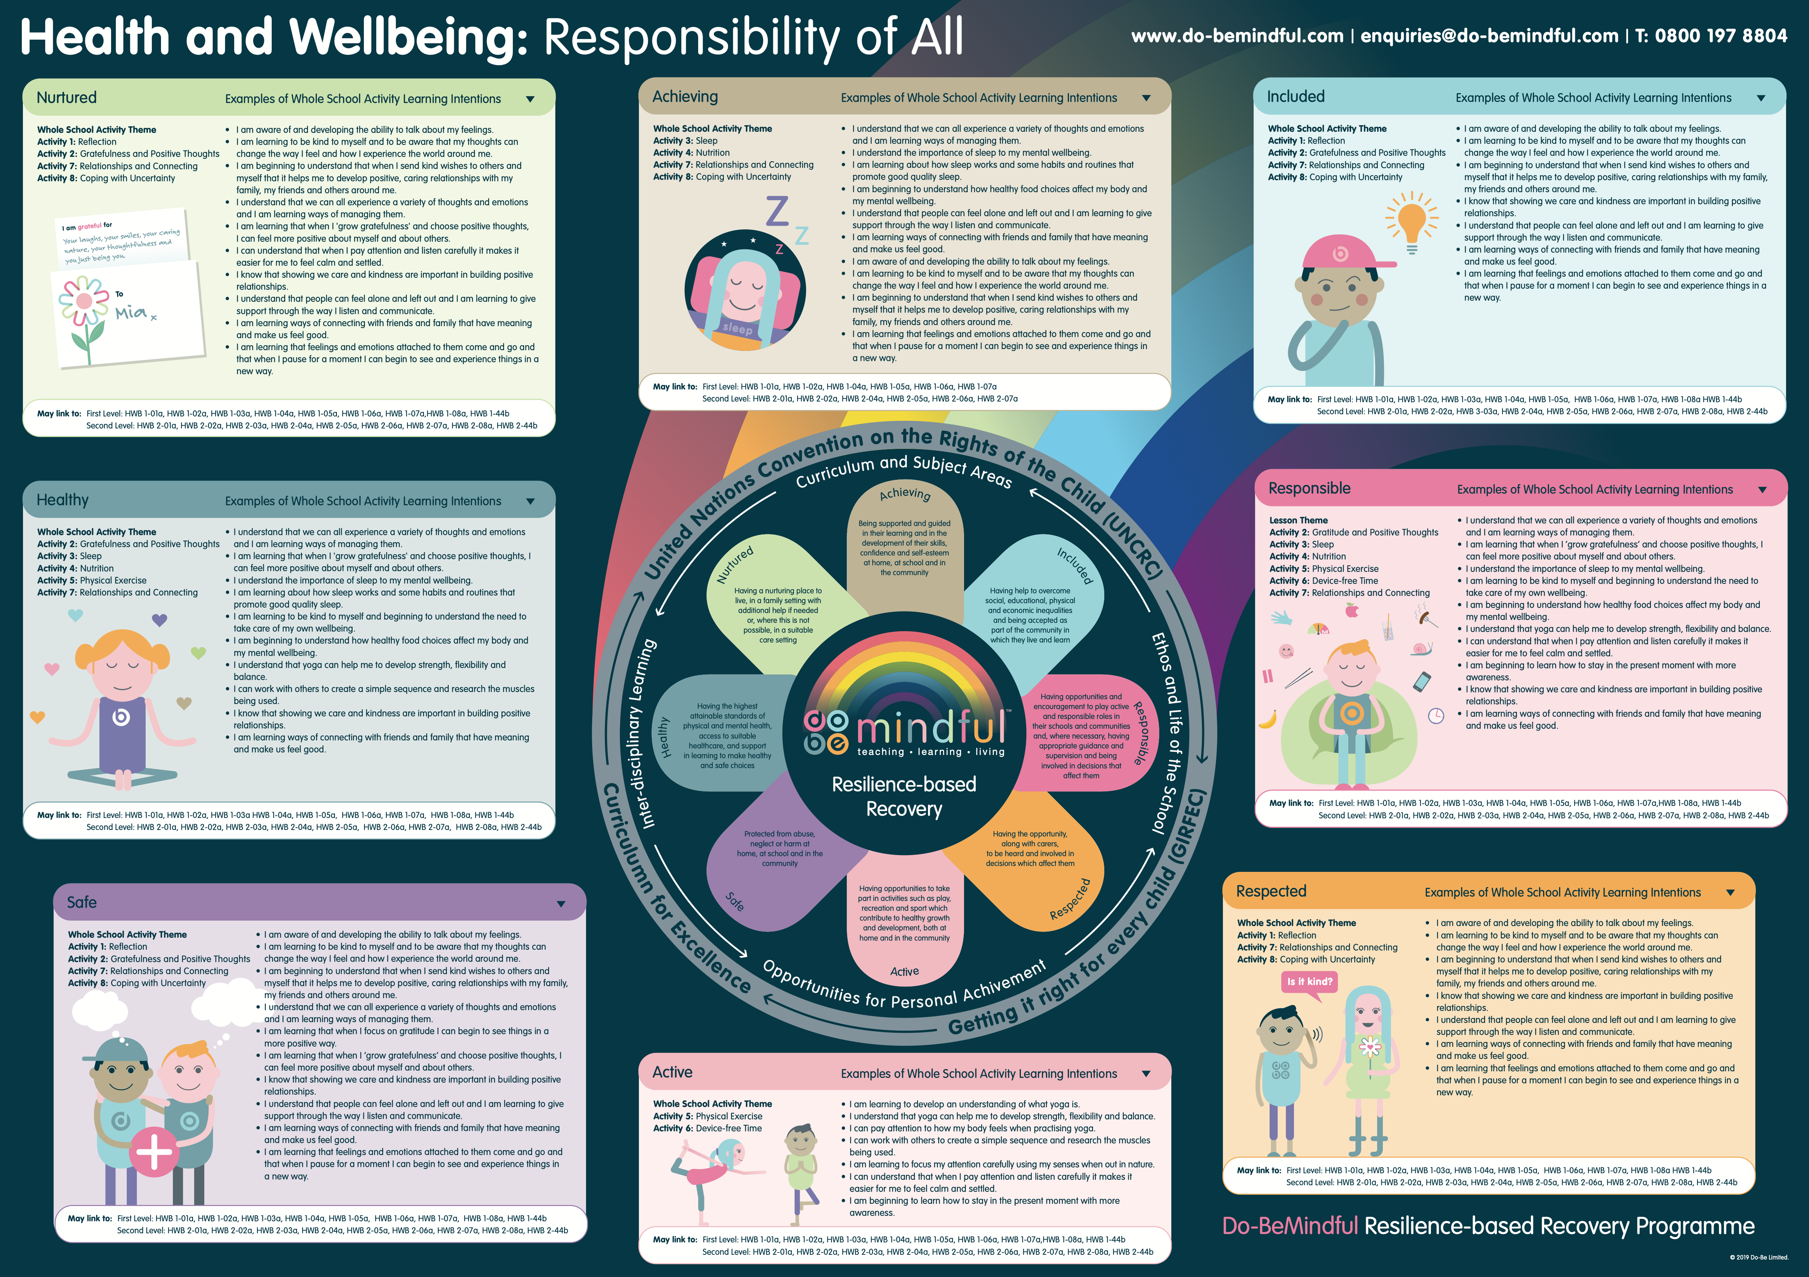

Slide 17
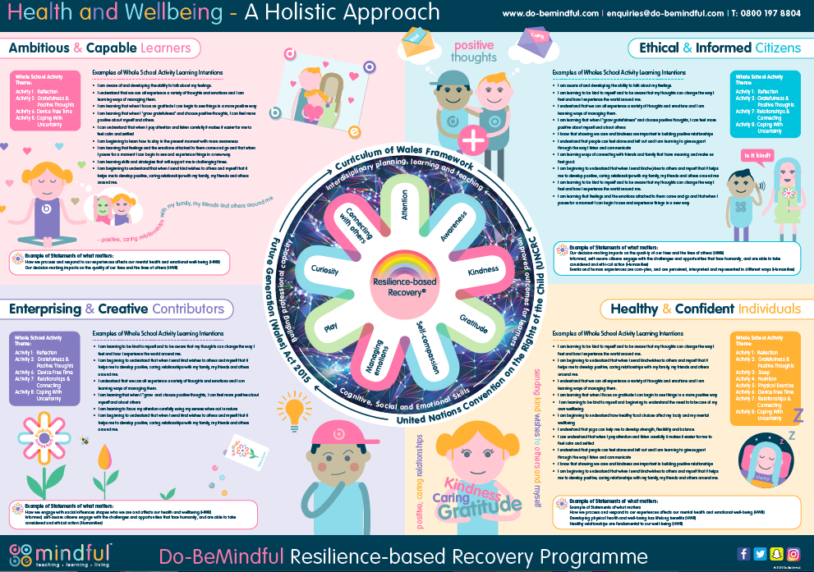

Slide 19
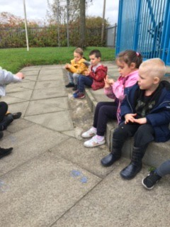
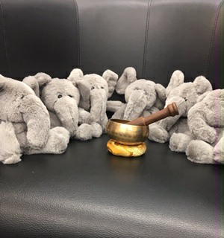
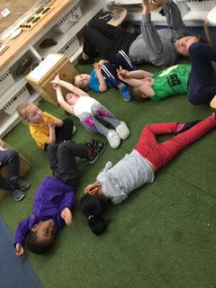
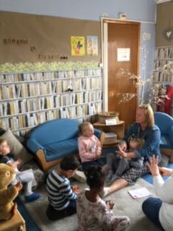
Bonnybroom Nursery
cmclauchlan@bonnybroom-nursery.glasgow.sch.uk

Slide 20
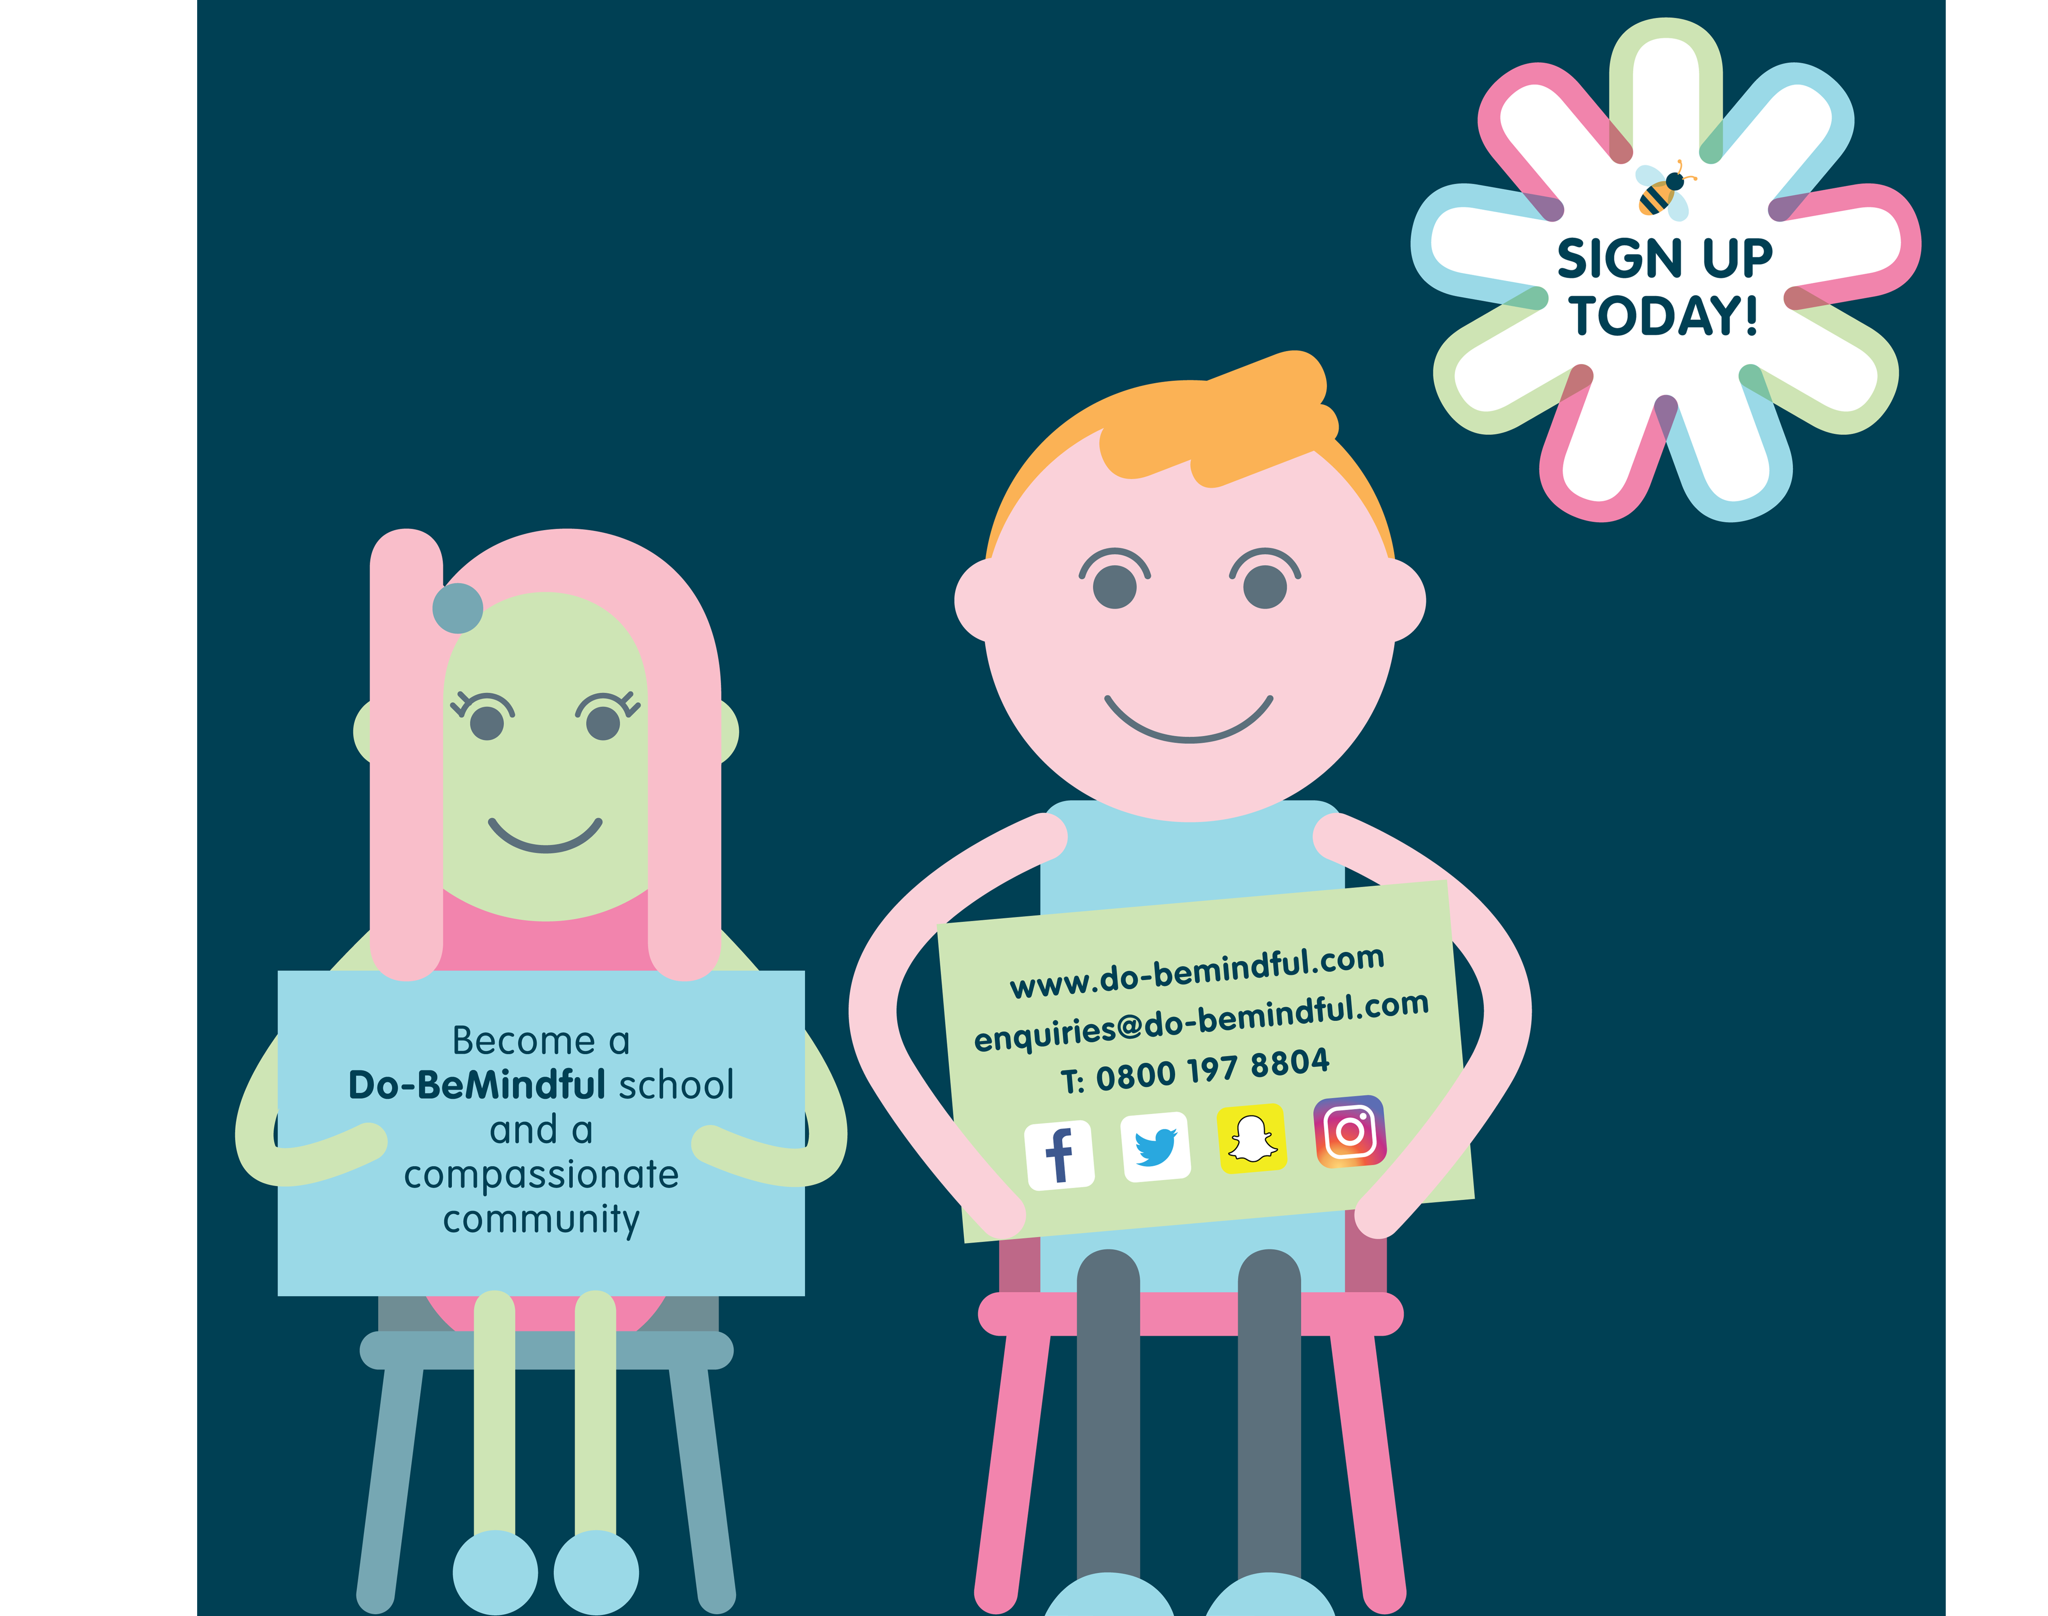
Questions?
Do-BeMindful - Facebook
@dobelou - twitter
louise@do-bemindful.com

